Slide 1

PRICE COMPARE BY TEAM 28
SHOP SMART
Shop smart at the right price

Slide 2
NAME OF TEAM MEMBERS
DESIGNERS
Temola Remi - Remmy
Chiluba Sarah Banda
Ismaeel Owolabi - Hismyhill
Kareem Balikis - Kohinoor
Vohkeh Osusuluwa- Vohkeh
Nancy Anslem - Nancy
Maryjuan Asieru - Juannyn
Favour Wendee- Wendee
Solanke Esther - estheromotola
Sobowale Samuel - samsobocreations
Ibeawuchi Lynda - Lynda Ibeawuchi
DEVELOPERS
Adeoluwa Agbakosi - 180 Memes
Akintade Olumuyiwa - Exousia
Angel OkeyMoses - Angel
Ifeyinwa Nwabueze
Ejimole Eudora - Eudora
Viashima Collins - Clins10
Godswill Utong - g_v_utong
Timi Babalola - Olutimi
Ebenezer Somtochi - Pascal
Hussein Khidr – Khidr
Kingsley Isong –saint_kedro

Slide 3
SHOP SMART Shop smart at the right price

Slide 4
INTRODUTION
Price comparison websites are also known as “Aggregators” because they aggregate information on a product from many websites offering online shopping of the product. These sites render you easy lucid comparisons of the prices on offer of product under consideration, without any toiling involved, on a single screen in a matter of few clicks of the mouse. The sites manage to save a substantial amount of effort, time and money of the prospective shopper, and above all, take away the headache of compiling information.

Slide 5
SHOP SMART
As a startup, we decided to niche down to technological Gadgets, that is mobile phones, tablets laptops and others. As we grow we hope to have more niches so we can have a more varied price compare platform

Slide 6
RESEARCH METHODLOGY
RESEARCH METHOD: In our research, we employed both the quantitative research method where we interviewed one on one, some respondents as well as a quantitative research method to understand the needs and challenges of our users.
This implies that in designing the shopsmart platform, the website was based on actual research from end users.
The data we collected was used for our design thinking process as evident in the user persona, brainstorming and idea prioritization

Slide 7
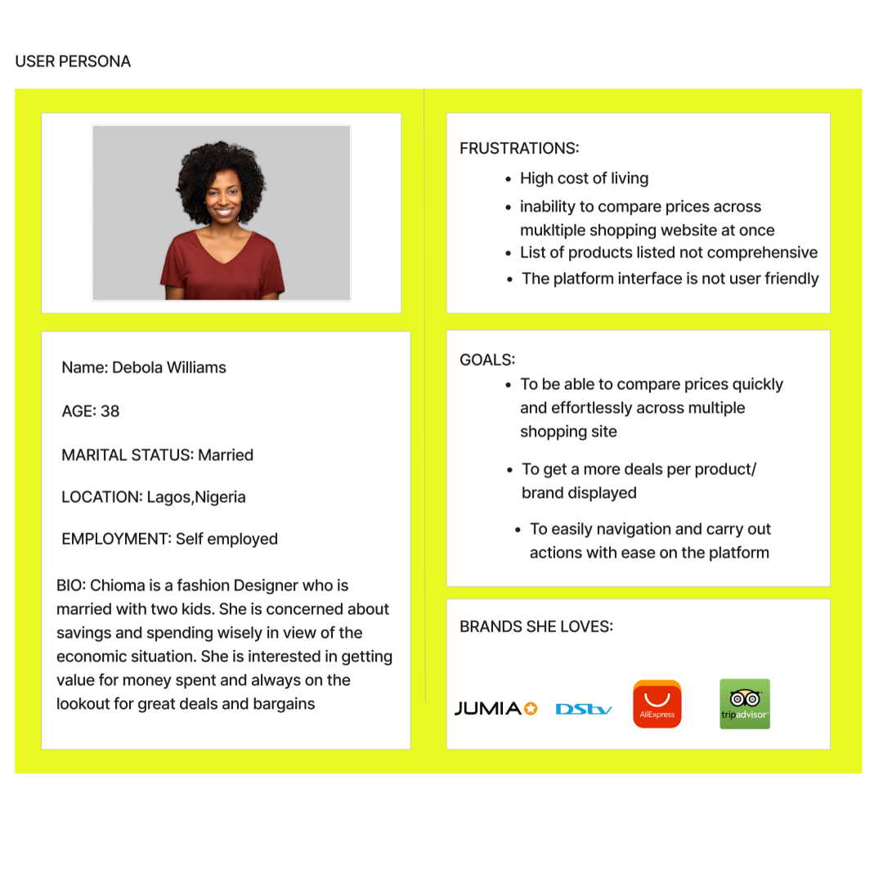
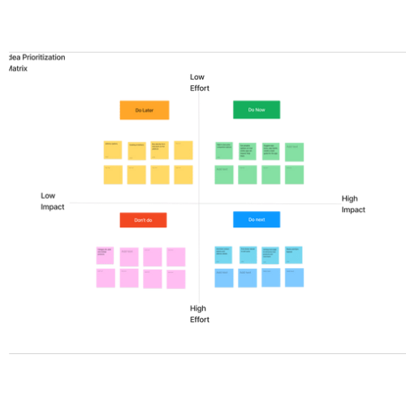
USER PERSONA AND EMPATHY MAP

Slide 8
USERS
The shop smart price compare platform will cater to the needs of consumers as well as vendors who will list their products on the site and register as Merchants

Slide 9
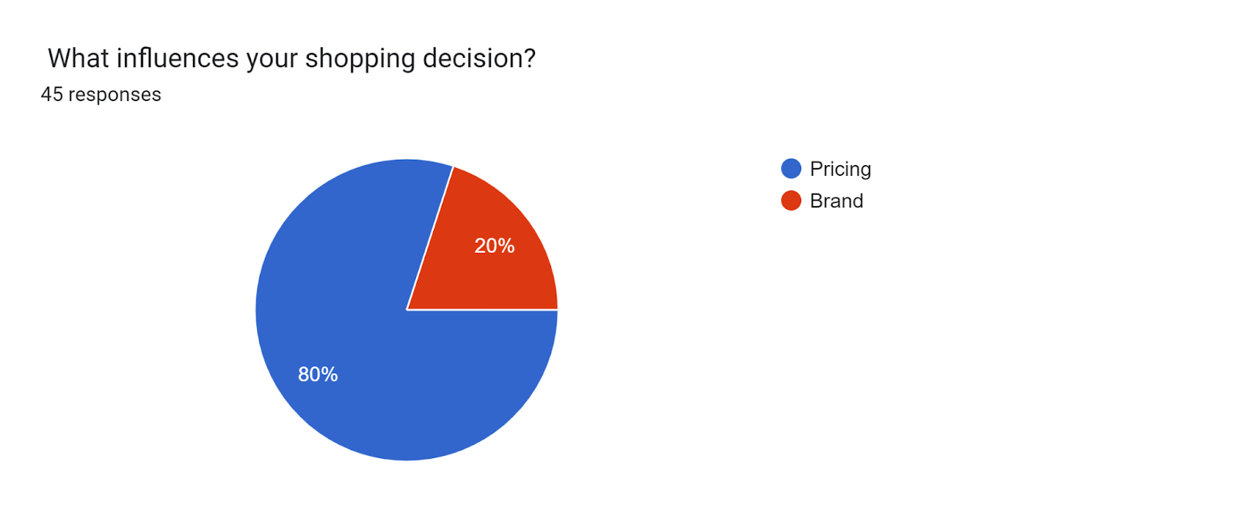
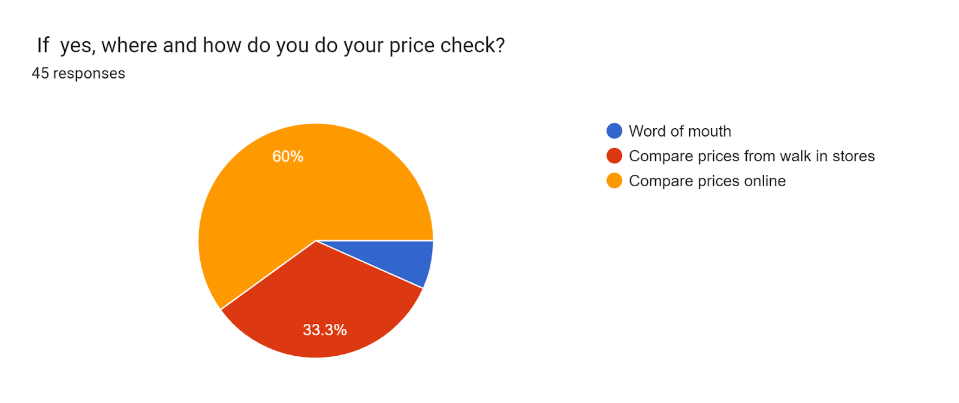
USP (Uniques Selling Point) Of Shop Smart
In designing the shop smart platform,

Slide 10

our website design and features was based on actual research from end users and a designing thinking process.
Our research findings reveals that 80% our respondents purchase decision is greatly influences by price, while 60% compare online, about 33.3% compare from Walk in stores, given how tedious it can be doing the comparison through walk in stores, As such during our design think process we decided to embed their needs by creation a page to help them compare great deals from to notable walk in stores of notable walk in stores of popular brands. They thus have the option to call the merchant to place their order or go to the store to make their actual purchase
Our research also reveals that end users would appreciate a real time status of products that were previously uploaded on the platform, so we added a status feature for each product status so they know if it is available, price increased or sold out

Slide 11
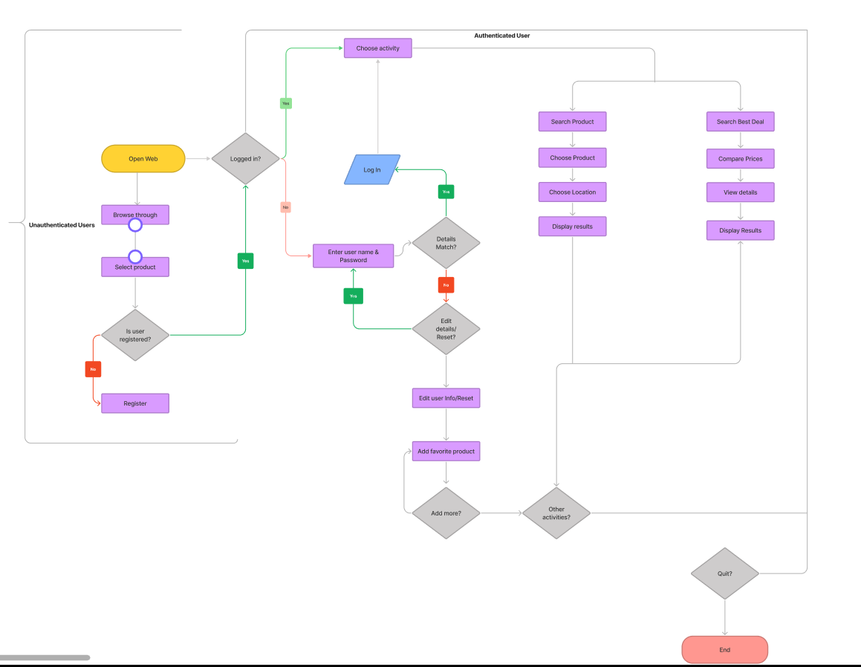
USER FLOW

Slide 12
FEATURES REQUEST
Users: Unauthenticated
The user visits the platform to view basic product information, pricing, and reviews. The documentation is viewed and interacted with by the users. The user can now browse available products after interacting with the documentation. The user can use the search features to browse available products. To gain access to additional features, the user must first register with their email address and password, or via one of the following methods: Google account, Facebook account, or Twitter account.
Users: Authenticated
The user now has full access to the platform after registering. The user can look up product history and see similar product recommendations. The user can also leave a comment under the product/price. The user can add products to their watchlist and set a price change alert. The user can share on social media and email, has access to the purchase page, can write and view reviews, can view full product details, and can also view available sellers for the desired product.

Slide 13
LANDING PAGE

Slide 14
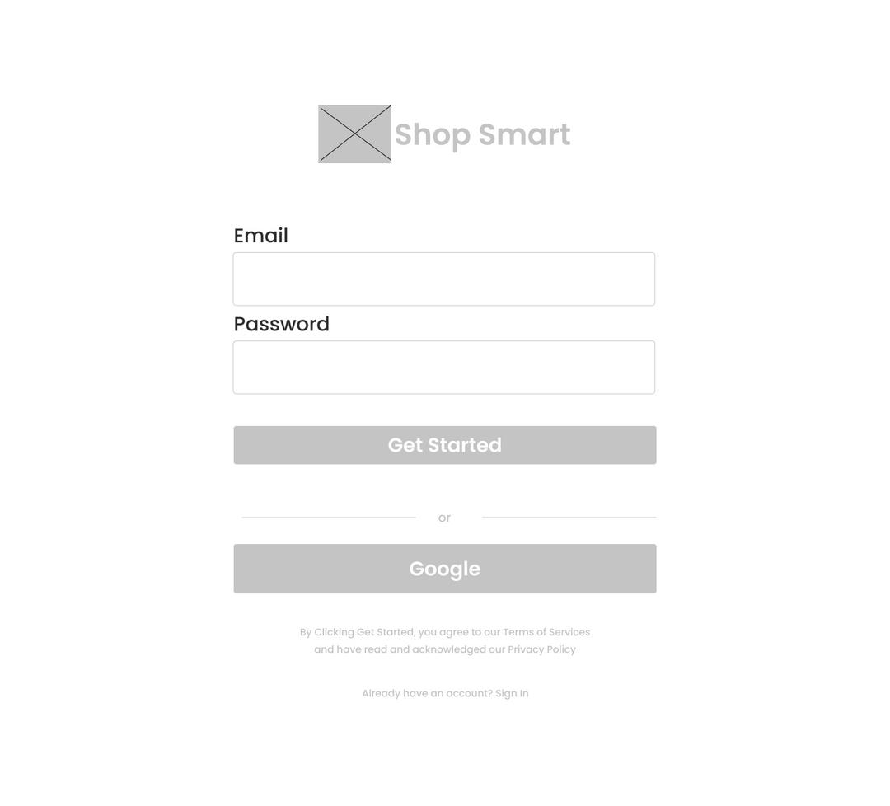
SIGN UP

Slide 15
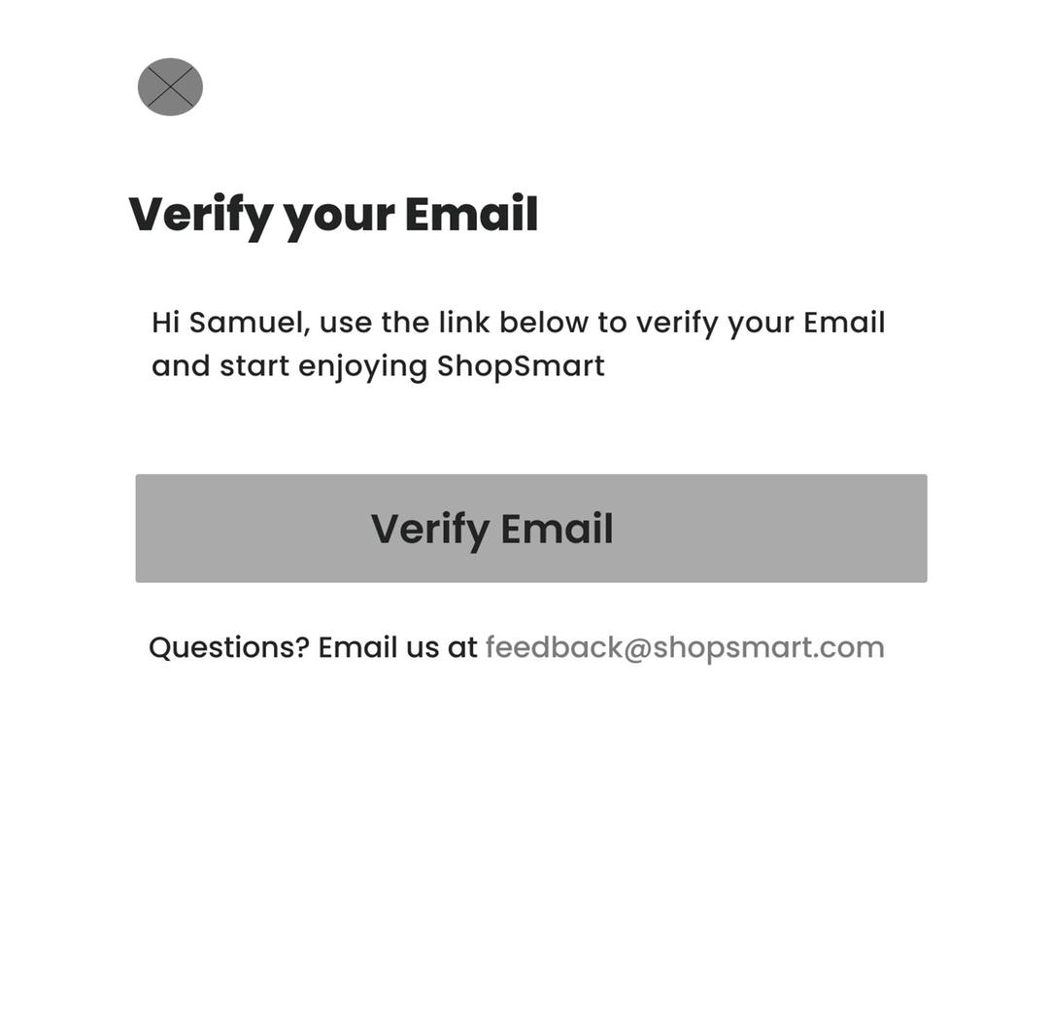
VERIFICATION

Slide 16
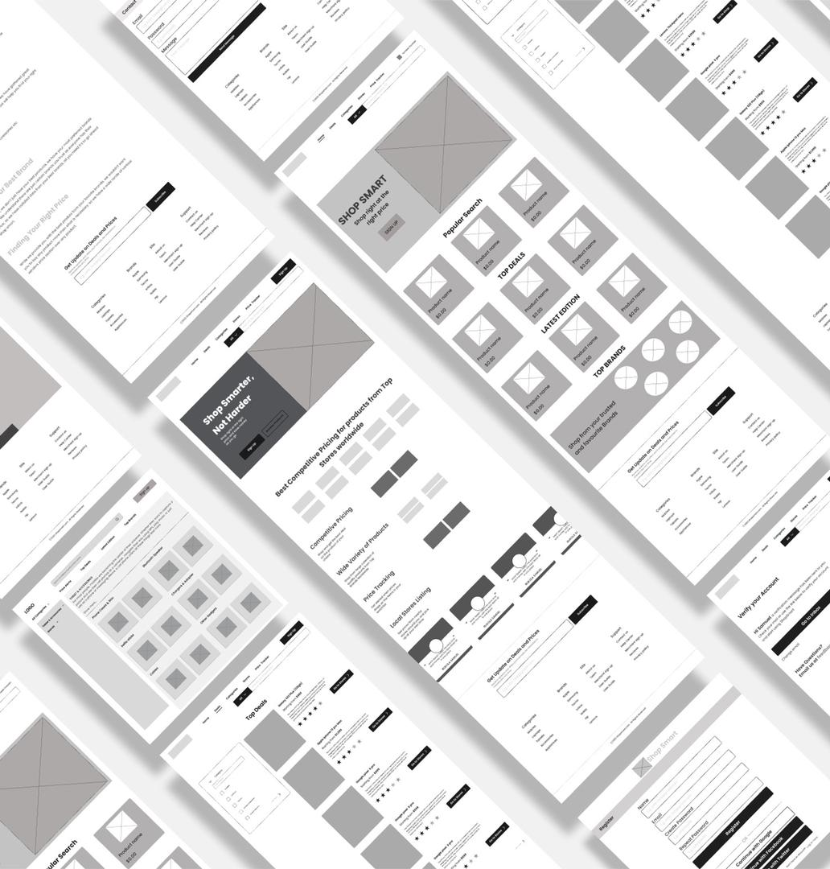

Slide 17
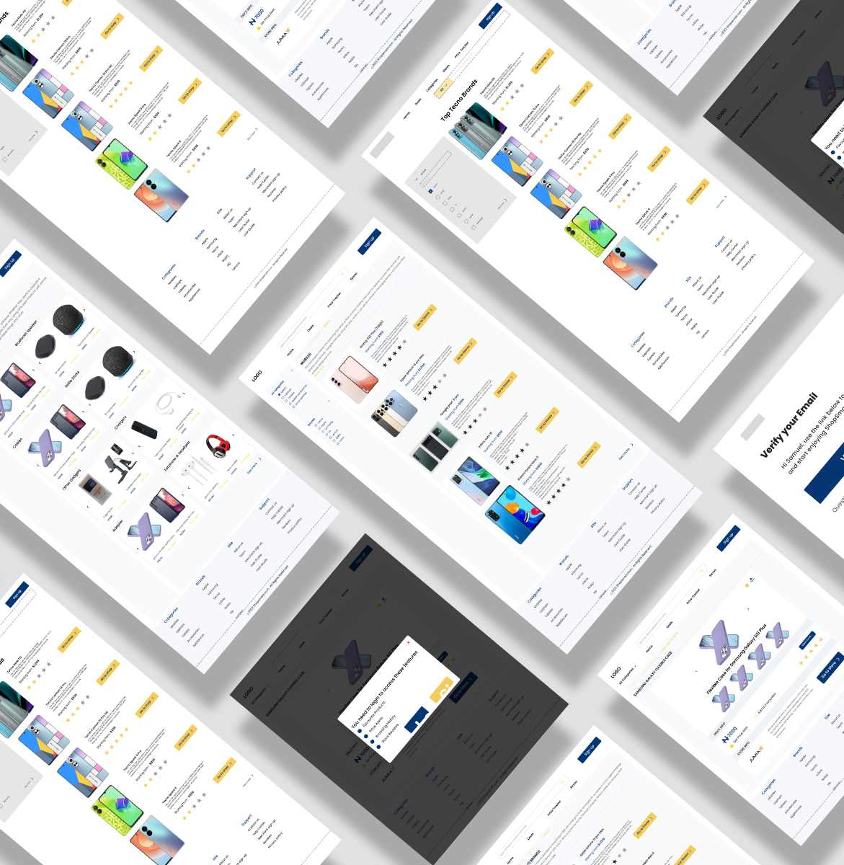

Slide 18
BENEFITS OF SHOP SMART
Shop Smart will be user friendly
One can check for cheaper price to get value for their money
Shop Smart is a all in one platform for Top brands, Latest deals, Promotional sales materials such as coupons, catalogues and online flyers.
Consumers love a good bargain as well as love to make informed purchase decision on best deals available and also allow them stick the budget.
Shop smart is a platform that will help them achieve these goods in one place and with ease
Email notifications.

Slide 19
TOOLS USED
The tools we employed in our design are are Jira ( a management tool that helped us to organize and track our project process ,Python Django, using APIs, figma and or Webscraping
We are webscraping some Nigerian ecommerce websites like Jumia, Konga, PointekOnline and lots more
For webscrapping we would be using selenium and we would be scraping either jumia and konga or amazon and flipkart

Slide 20
CONSLUSION
Shop Smart provides users with useful information that will help them making informed decision. With this price comparison websites, it solves the problems of the working people to check on price before buying products.
Our websites will serve as a platform or intermediary between buyers and sellers. It enables consumers to view various price lists for the products selected by the user, allowing them to make an informed decision about which products to purchase in order to save money. It also serves as a tool to assist consumers in increasing their price consciousness so that they do not feel cheated by advertisements from retailers claiming to offer the lowest price but actually offering the opposite.

Slide 21
THANK YOU FOR LISTENING

